Slide 1

Multiple server queuing model - m/m/k system
By : A.Lakshmikanth

Slide 2
introduction
The project is aimed to develop content in covid-19 category. More than ever the need for the personal healthcare and hygienic life is gaining more importance.
Covid-19 teaches every human being to maintain social distance, to take preventive measures with masks and washing hands regularly.
People gathering at different places in long queues and not following preventive measures like social distancing are one of the reasons for spreading the disease.
The recent Pandemic situation which resulted with spreading corona due to social gatherings, long queue at heavy populated areas are one of the main reasons for global pandemic.
This results towards spreading the disease in enormous way within the population.
Queuing theory refers to the mathematical study of the formation and functioning of lines and queues.

Slide 3


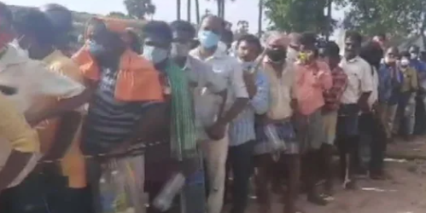
Covid-19 : A Universal Health Problem
Expected situation at covid test health centers
Current situation at covid test health centers

Slide 4

Self observation on issue
Recently, I visited one of the Covid Health care center to get Covid test and surprised with long queue with social distance and pushing each other.
I had to wait for 50 minutes in the queue in an enclosed hall before the sample was collected for the test.
Being a victim of this situation and resulted with Covid +ve.
I tried to understand the situation and wanted to model a multiple server queuing system and observe the queue with respect to time and also to find when would it be appropriate for me/anyone to go for the test again and at which time it would be faster?

Slide 5
Used Method
Used Materials
Matlab Version R2021a and its tools and functions.
Queuing theory.
The multiple server queuing system is used for analyzing the situation. In this model two or more servers are accessible to handle arriving customers.
To solve the situation, I tried to design a model with 3 servers which follows first come first serve condition. Where the arrival rates is lambda, and the service rate is mu with a finite population.
At the initial conditions there won’t be any customers in the system so the first customers will directly go to the servers and gets the service.

Slide 6

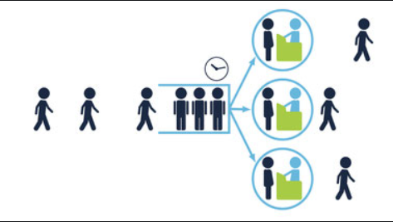
When the next customer arrives, they check the availability of the server and if it’s available the customer proceeds to that respected server. The customer waits in the queue if the server is not available.
So by this we can analyze the system and the length of the queue with respect to time which gives the efficient times for the customers to get their services done.

Slide 7
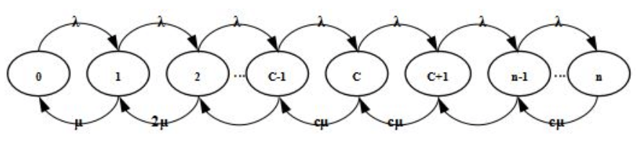
M/M/k Queuing system:
M represents that the states are Markovian. The state diagram is the best way to represent functioning of queue with a multiple servers.
The model is a type of birth and death process. The server utilization ρ = λ/(c μ) has to be less than unity for the queue to be stable and has stationary distribution.
This is a state transition diagram of M/M/k Queuing Model.

Slide 8
Result :
For,
Arrival rate = 5 per minute.
Service rate= 8 per minute.
Number of servers = 3.
We get a graph which represents the length of queue with respect to time. By this we can pinpoint the time where the length of queue is maximum and schedule the time accordingly. We also know the waiting time of the customer in the queue by which we can estimate and manage our visit to the center.
By this study, we can observe and analyze the queue of the test center at certain times which helps in scheduling the service and getting it done effectively.

Slide 9
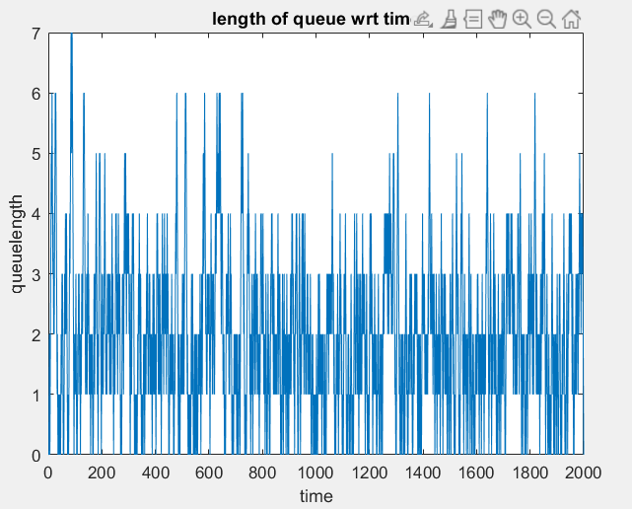
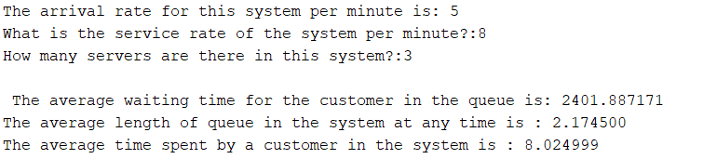
Result
Even though this model is for finite population. When the population increases the service rate has to be increased so as to cope up with the customers. When the population increases it is a bit difficult to find the minimum queue and schedule accordingly so, what we can do is to find the average length of queue and avoid the times where the length is maximum. We can also make this as a user defined function in Matlab and use it for various scenarios and other applications.

Slide 10
references
https://en.wikipedia.org/wiki/M/M/c_queue
https://www.win.tue.nl/~resing/SOR/eng/college10_09_eng.pdf
Matlab Documentation.
Lecture PPt’s and materials provided by Siamak Khatibi.

